Slide 1
Welcome

Slide 2
Introduce
MD.ABDUL HAKIM
BHUKSHIMOL MADRASHA
Class: Ten Sub: English(1st paper) Unseen : Passage

Slide 3
Warm up

Slide 4
Topic name
Green House Effect

Slide 5
Learning outcomes
# After reading the passage S’s will be able to------
understand the text through word meaning and silent reading
Answer to questions
guess the main idea

Slide 6
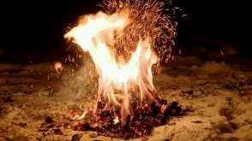
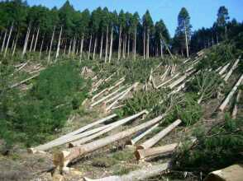
Combusion (n)
Burning
Deforestation(n)
Cutting down

Slide 7
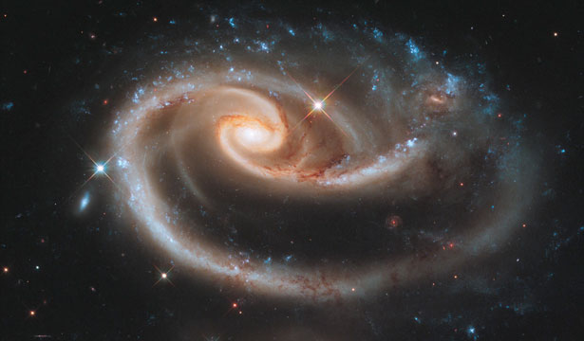
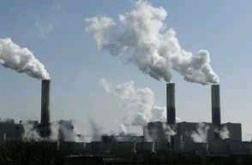
Cosmological (adj)
Relating to universe
Emission (n)
Release

Slide 8
Greenhouse effect
Fossil fual
Increasing CO2
Reduce CO2

Slide 9
Group work
*How do the factories produce energy?
*What are the other purposes for which coal is burnet?

Slide 10
Evaluation
*What is the main cause of green house effect?
*What can man control?
*What is the text about?

Slide 11
Home task
Write the summary of the passage

Slide 12
Thank you

